Slide 1


How To Export
Cross
Building Business Intelligence unit
Safwat Sobhy

Slide 2
EVERY ONE WILL SAY
YOU MUST DO IT …
BUT I WILL ….HELP YOU TO DO IT ….ACTUALLY
Safwat Sobhy

Slide 3

IN EXPORTING ..THE PROBLEM IS FIND OR CREAT BUSINESS OPPORTIUNITY .. NOT ADERTISING VIA SOCIAL MEDIA
JUST YOU MUST KNOW THAT
SOCIAL MEDIA IS A TOOL ……NOT SOLUTION

Slide 4
FACTORS OF PROBLEM IN EXPORT
THE REAL PROBLEM IS INFORMATION LEAKAGE BETWEEN
TELL ME WHAT YOU WANT
HIDDEN OPPORTUINTY
AND WILL GIVE YOU WHAT YOU NEED
MARKET NEEDS
ADVERTISING WITH
NO ASKING ABOUT NEED
RESULT IS .. Disorientation Between Online Results And Real Result As Business Request

Slide 5
Building Export System Cross Intelligence unit
PRACTICALLY
1- HOW TO USE GOOGLE TREND TO KNOW ABOUT IMPORTERS NEEDS IN ANY COUNTRY
2- HOW TO USE GOOGLE ALERT TO MAKE AUTOMAITC DATA COLLECTION ABOUT AGRICULTURE MARKETS
3- HOW TO FIND KEYWORDS THAT IMPORTERS USE IN SERACH PROCESS ABOUT AGRICULTURE PRODUCT IN ANY COUNTRY

Slide 6
Building Export System Via Intelligence unit
PRACTICALLY
4- HOW TO SEARCH ABOUT BUSINESS CULTURE IN ANY COUNTRY TO UNDERSTAND HOW YOU CAN INTRODUCE YOUR PRODUCTS
5- HOW TO MAKE ANALYSIS FOR INTENRATIONAL MARKET GAPS TO EXTRACT NEW EXPORT OPPORTUNITY
6- HOW TO USE TRADEMAP AND EXPORT POTENTIAL MAP TO FIND & UNDERSTAND TARGET MARKET

Slide 7
Building Export System Via Intelligence unit
PRACTICALLY
7- HOW TO USE GOOGLE CORRECLTY TO FIND GLOBAL MARKET PRICES FOR AGRICULTURE PRODUCTS
( FIND GLOBAL AGRICULRUE PRICES)
8-HOW TO MAKE PRACTICAL EXPORT PLAN
9-HOW TO FIND IMPORTERS CONTACT DATA

Slide 8
Building Export System Via Intelligence unit
PRACTICALLY
10 –HOW TO INTRODUCE YOUR COMPANY IN ONE PAGE
( FLYER )
11- PRACTICAL STEPS FOR EMAIL MARKETING
12- PRACTICAL STEPS FOR MARKETING IN AFRICAN COUNTRIES
13- HOW TO MAKE EXPORTING OFFER IN ONE PAGE ( FLYER )
14- AFTER DEAL NEGOTIATIATION

Slide 9
Building Export System Via Intelligence unit
PRACTICALLY
15- INCO TEREMS PRACTICALLY ( HOW TO CALCULATE YOUR PRICE UNDER F.O.B – CFR- CIF AND OTHER TREMS )
16- PRACTICAL LOGISITCS PROCESS
*- HOW TO COLLECT OCEAN FREIGHT PRICES DIRECLTY FROM SHIPPING LINES ( No Forwarder )
*- HOW TO COLLECT TRUCKING PRICES DIRECLTY ( No forwarder)
*- HOW TO MANAGE CUSTOMS CLEARANCE PR DIRECTLY
( No Forwarder)

Slide 10

17 - RECRUITMENT OF INFORMATION SOURCES

Slide 11

OTHER SUPPORT TOOLS FOR LOGISTICS

Slide 12
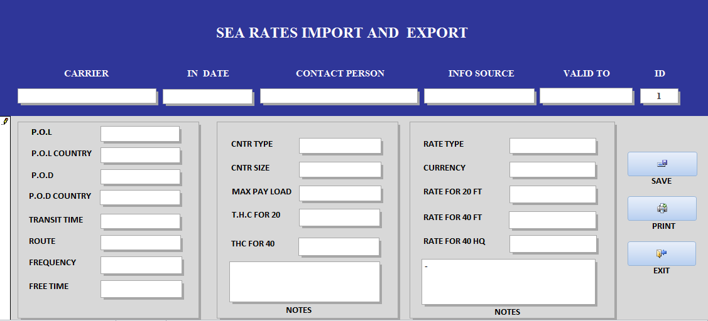
MS ACCESS FCL RATES DATA BASE
( PROGRAMMED BY SAFWAT SOBHY )

Slide 13
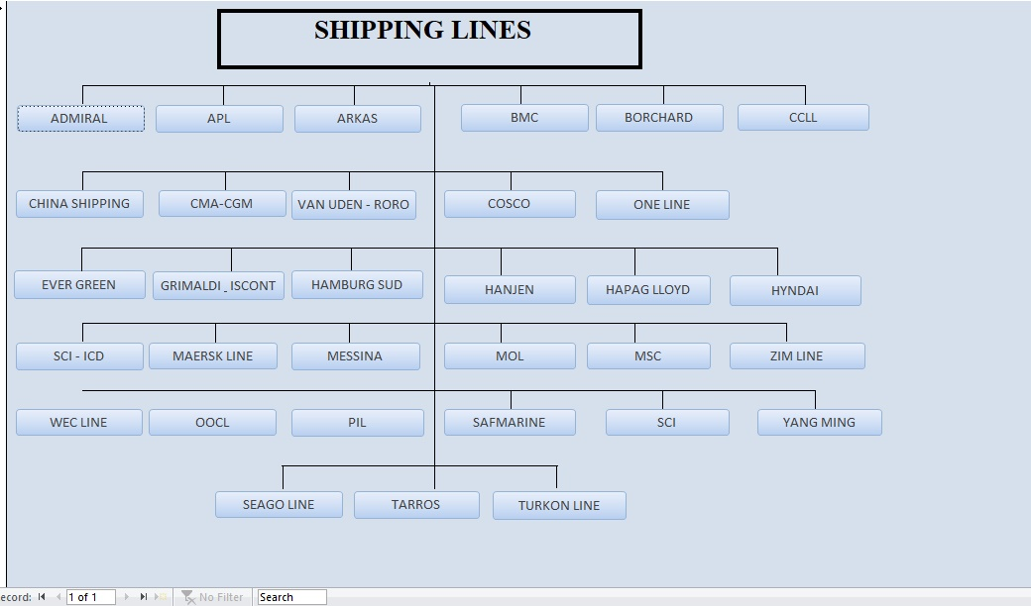
PRACTICALLY
Building Export System Via Intelligence unit
17 – UNDERSTAND DATABASE OF WORLD SEA PORTS
18- USING SHIPPING LINES DATABASE ( BY SAFWAT SOBHY)

Slide 14
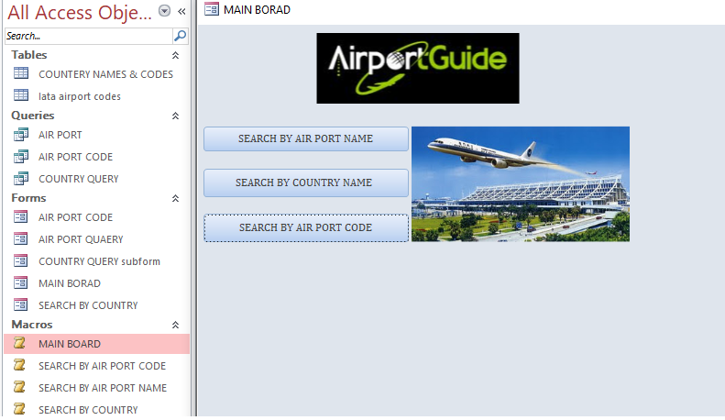
Building Export System Via Intelligence unit
WORLD AIR PORTS DATABASE ( BY SAFWAT SOBHY)

Slide 15
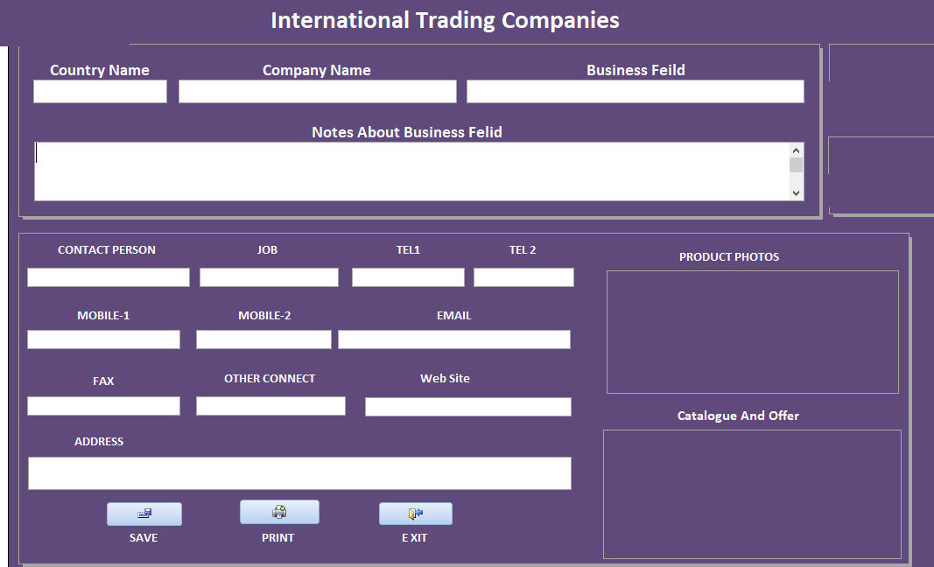
Building Export System Via Intelligence unit
SALES LEADS ORGANIZER ( BY SAFWAT SOBHY )

Slide 16
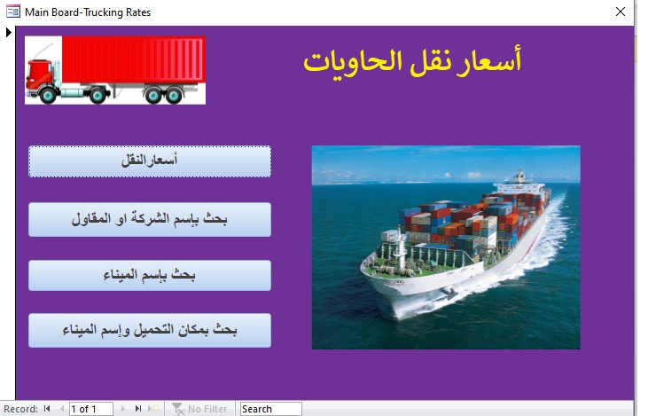
Building Export System Via Intelligence unit
TRUCKING RATES DATA BASE ( BY SAFWAT SOBHY

Slide 18
Building Export System Via Intelligence unit
FINALLY >>EXPLAIN FULL EXPORT DOCUMENTATION PROCESS WITH PRACTICAL FORMS
NOTES : EVERY TRAINEE WILL TAKE CD CONTAINS ALL DATABASES
*- IF AVAILABLE (TRAINEE CAN USE HIS OWN LAPTOP TO APPLY ALL STEPS ONTIME
*- IF AVAILABLE (TRAINEE CAN USE HIS MOBILE APPLY MOST OF STEPS ONTIME

